Slide 1
COMP 3100
Week 2 - Wednesday

Slide 2
Last time
What did we talk about last time?
Continued introduction to software engineering
Git, GitHub, and version control systems

Slide 3
Questions?

Slide 4
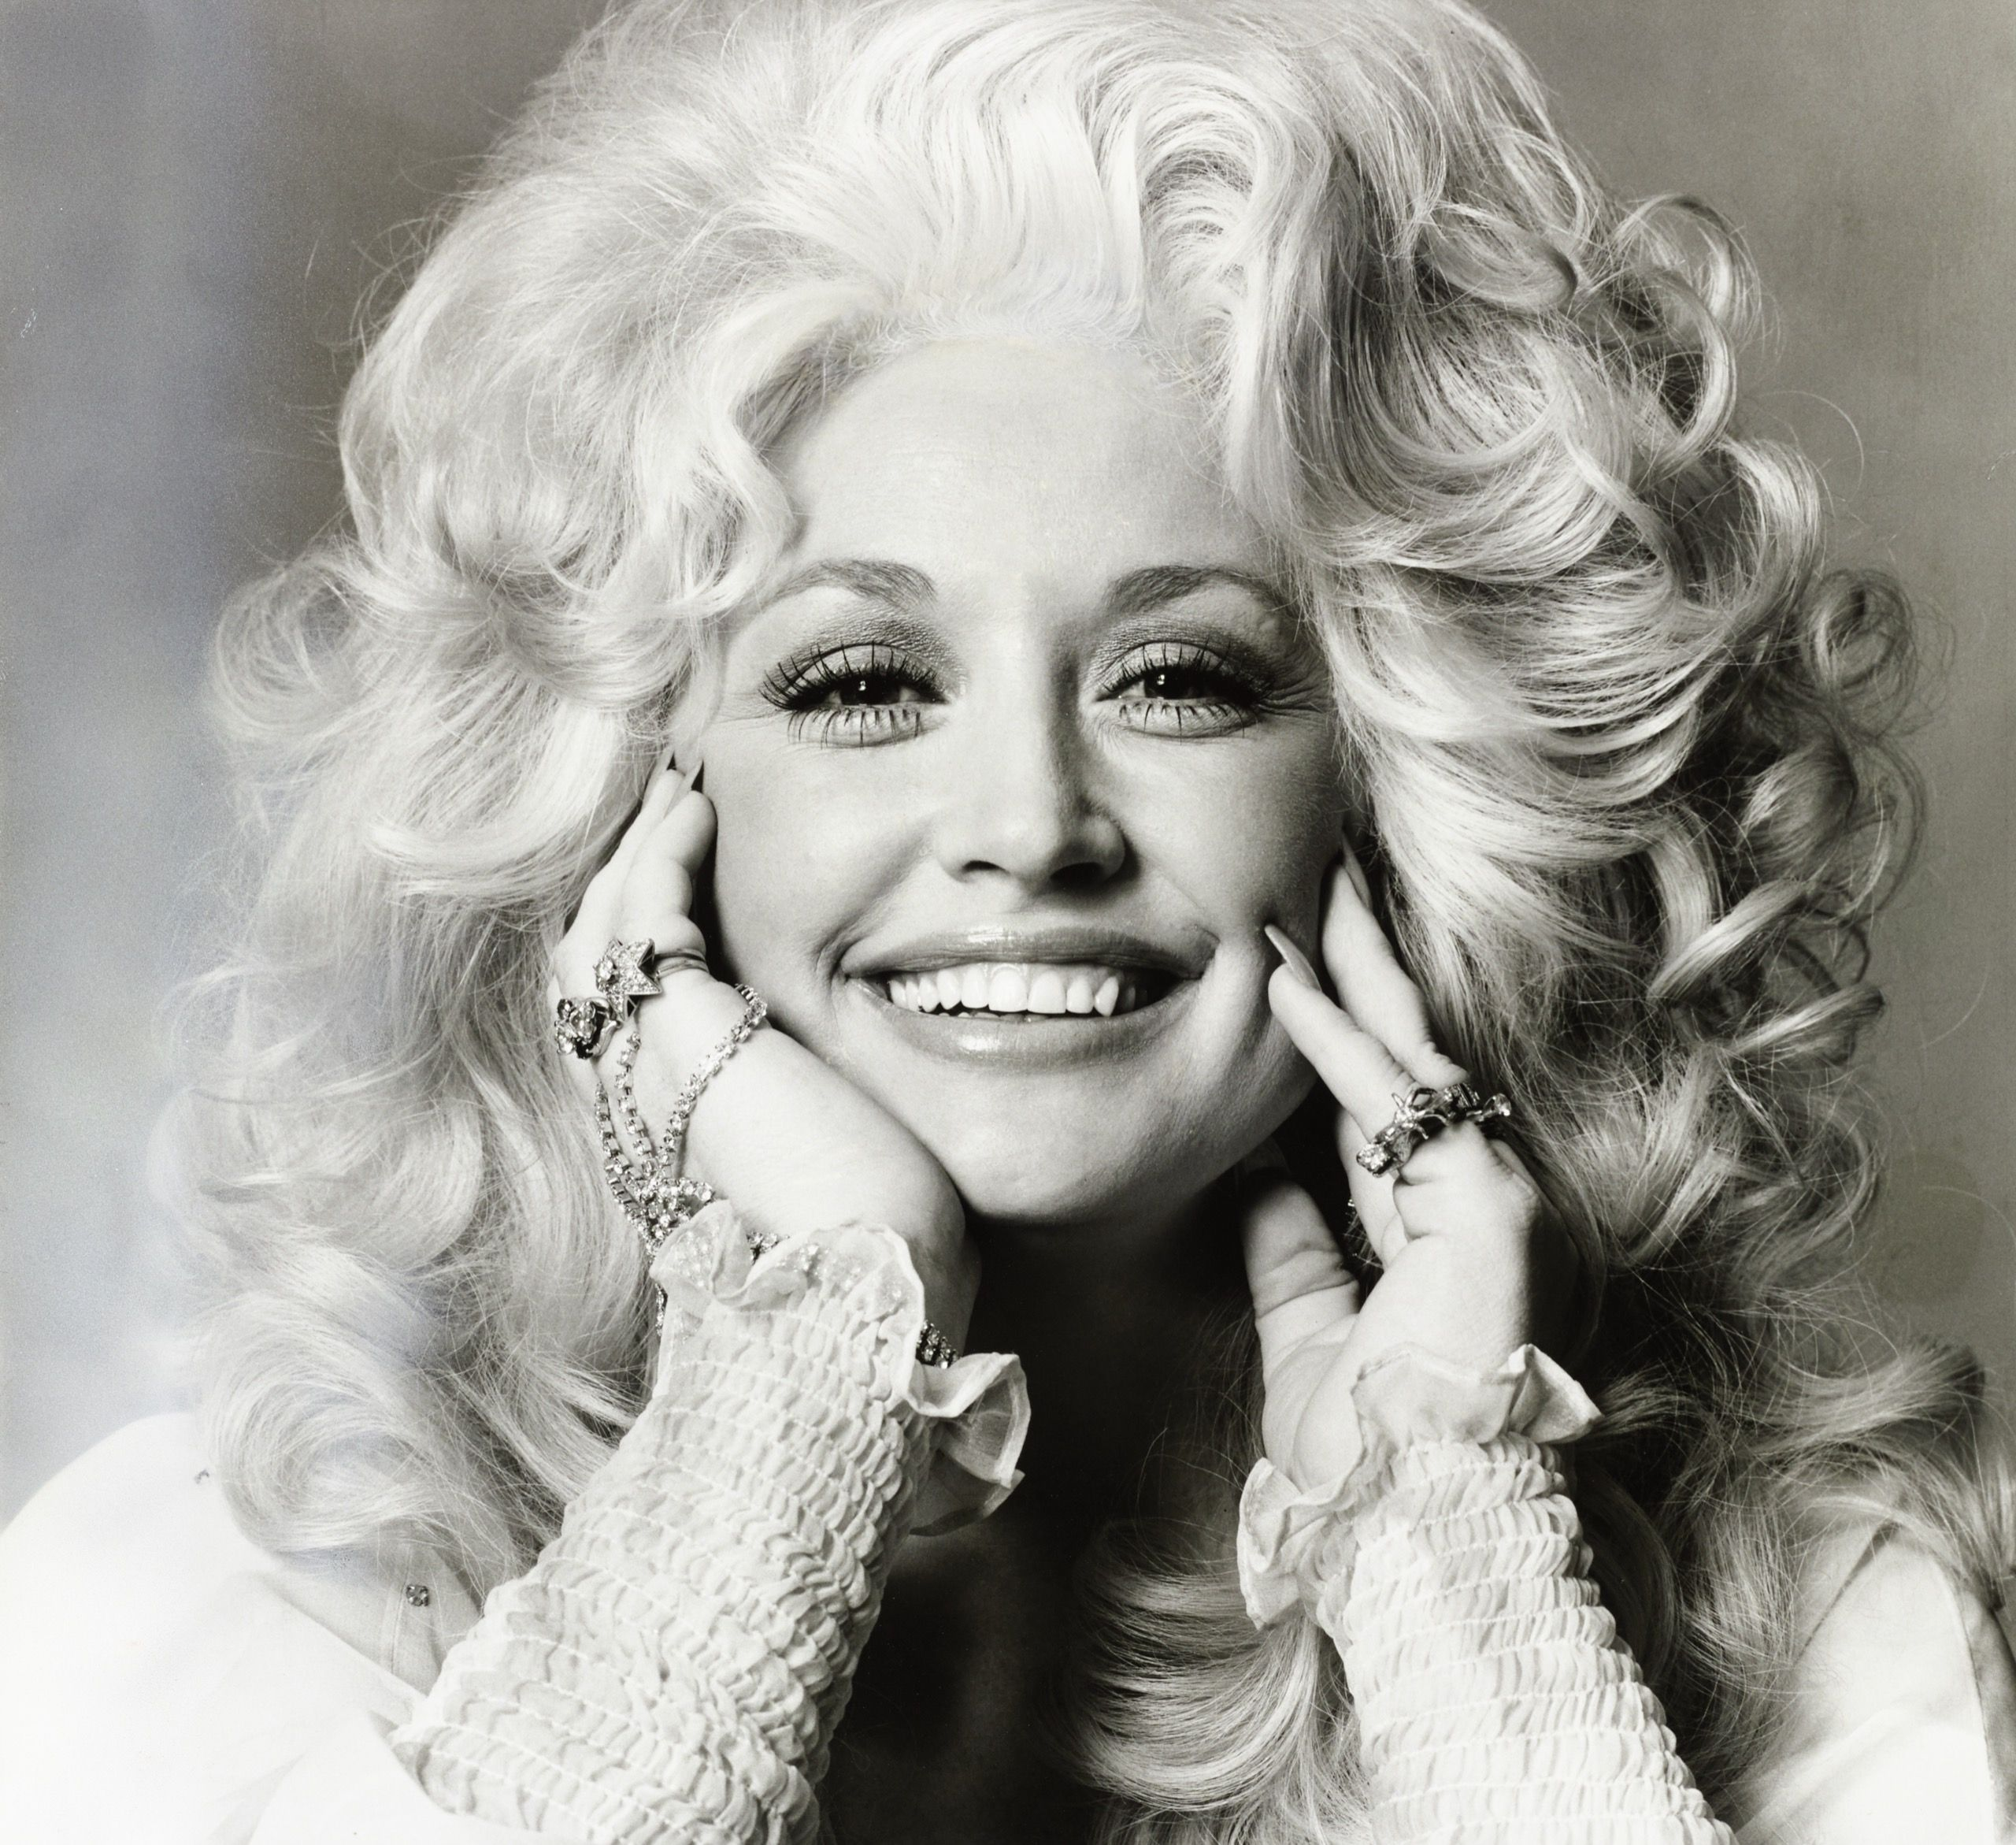
Dolly
Parton
1946 - 2026

Slide 5
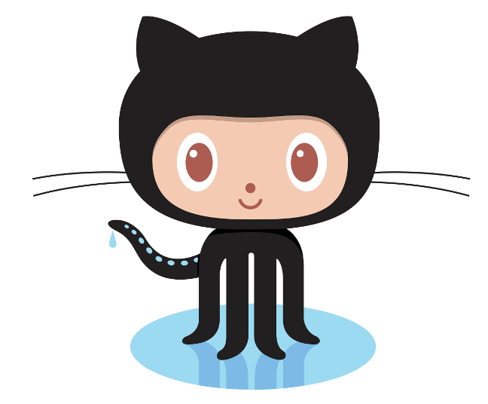
GitHub
GitHub.com provides online repositories for code
  Private repositories used to cost money, but now they are free until you use too much space
  Public repositories have fewer restrictions
Git can be used without GitHub
GitHub can even be used without Git (since it has support for SVN)
GitHub has nice tools for:
  Visualizing who's committing and how much they have changed
  Issue tracking
  Writing commit information and Read Me files
  Pushing and pulling repos stored on GitHub
  Creating webpages related to releasing software
Ironically, Linus Torvalds hates GitHub

Slide 6
Requirements

Slide 7
Terminology
A requirement is a property or behavior a product must exhibit
A specification is a precise description
A requirements specification is (unsurprisingly) a precise description of the properties or behaviors a product must have

Slide 8
Stakeholders
Stakeholders are anyone affected by a product or its development
  Customers are the people that pay for a product
  Users are people who interact with the product
  Clients are people for whom software was created (includes both customers and users)
  Developers are all the people who work on the project
  Regulators are responsible for ensuring that software meets standards
  Marketers stand in for clients when making mass-market products

Slide 9
Stakeholder needs
All the stakeholders have needs, but not all of these needs can or should be requirements
Stakeholder needs are frequently in conflict
  It's a pain to put good privacy controls into a product
  But regulators might require it
Stakeholder needs are incomplete and sometimes incorrect
Stakeholders needs are often abstract
  "The game should be awesome."

Slide 10
More on stakeholder needs
A stakeholder need is a feature that one or more stakeholders want
Sometimes, these needs are written in descriptions called needs specifications
Then, developers have to wrangle all of these conflicting, incomplete, and vague needs into a requirements specification
Traditional methods may have a specific person who does this
  Titles like requirements analyst, requirements specialist, user interaction designer

Slide 11
Functional and non-functional requirements
It's common to divide requirements into functional and non-functional categories
Functional requirements are about how software takes input and turns it into output, its behavior
  Appearance
  User interface actions
  Input and output processes
Most requirements are functional requirements, and they take the most time and effort to specify

Slide 12
Non-functional requirements
Non-functional requirements describe the properties software must have
  Speed of processing
  Amount of memory used
  How often failures can be permitted
  Level of security
  Ease of modification
  Cost of development
  Platforms the product must run on
Non-functional requirements are more abstract than functional requirements
Functional requirements are tied to specific pieces of code, but non-functional requirements are properties of the whole system

Slide 13
Abstraction in specification
This example from the book shows the same specification from abstract to concrete:
  The product must provide an online bookstore shopping experience.
  The product must provide titles and descriptions of books from which users may choose books to purchase.
  The product must allow shoppers to buy books by placing them in a shopping cart.
  The product must display a button with each book description that when pressed places books in the shopper’s cart.
  The product must display a button labeled "Buy" that maintains a constant position (despite scrolling) at the upper right-hand corner of a book-description web page. When pressed, this button must place the book whose description is displayed into the shopper’s cart.

Slide 14
Levels of abstraction
Business requirements specifications are client objectives that must be met
  They are abstract descriptions of the product
  They might include deadlines or sales targets
  They're usually non-functional requirements
User-level needs and requirements are one step more concrete
  They describe tasks or goals that the product would allow a user to perform
  These tend to describe what the product does but not how
  Could be functional or non-functional

Slide 15
More levels of abstraction
Operational-level needs and requirements describe individual inputs and outputs
  These are more specific than user-level needs and requirements
  Example: The product must allow users to enter polynomial equations, trigonometric equations, logarithmic equations, and exponential equations, all of one variable.
Physical-level needs and requirements are about the appearance and formatting of the user interface
  These will describe what the product actually looks like (which might be several different descriptions if the same product works on a desktop and a phone)
  Example: The product must provide a text box for equation input. The text box must display 50 characters and scroll vertically up to 800 lines.

Slide 16
Requirements in traditional processes
Most of the terminology we've been using comes out of traditional software development processes like waterfall
In that paradigm, requirements must be gathered first, followed by design, followed by implementation, testing, and maintenance
The requirements must be frozen so that the next steps can take place
Then, no one wants to change the requirements because you'll have to redo everything that comes after, which is expensive

Slide 17
Problems with requirements in traditional processes
It's really hard to figure out all the requirements before doing any coding and looking at prototypes
The world changes quickly, especially in technology, and people's desires change
Writing all the requirements takes a lot of work, creates large documents, and costs a lot of money
The waterfall process means that nothing is ready for a long time (often years) after the project starts, and some projects get canceled

Slide 18
Requirements in agile processes
Agile developers try not to write requirements at all
  But you have to start with something ...
Stakeholder needs are turned into lists called product backlogs
A product owner adds to the product backlogs and prioritizes them
High priority items are chosen for each sprint, the agile term for a development iteration

Slide 19
How Scrum tries to make changing requirements cheap and easy
Delay choosing requirements as long as possible
  Stakeholder needs can be easily added or removed from the product backlog
  Requirements are set only for the product backlog items (PBIs) when they're implemented on a sprint
Delay refinement as long as possible
  PBIs are broken down until they're small enough and detailed enough for a single sprint
  User-level requirements are refined into operational- and physical-level requirements for the sprint where they're implemented
Avoid writing requirements altogether
  Instead of writing down physical-level requirements, talk to the stakeholders and implement what they say in the sprint
Determine requirements in light of current product features
  Because agile methods iterate on an existing product, everyone can see which features would be most useful next

Slide 20
Stating specifications in traditional processes
Specifications are usually made in declarative English (or appropriate natural language) sentences
Problem: English is vague and confusing
Rules for good technical writing:
  Write complete, simple sentences in the active voice
  Define terms clearly and use them consistently
  Avoid synonyms
  Group related material into sections
  Use tables, lists, indentation, white space, and other formatting aids
Use "must" or "shall" to describe behaviors the product must do

Slide 21
Testable requirements
Requirements should be testable or verifiable
This means that there can be a process for testing whether the product meets the requirement
Bad requirement:
  The product must display query results quickly.
Good requirement:
  The product must display query results in less than one second.
The bad requirement isn't testable because "quickly" is subjective
The good requirement is testable because we can time the finished system

Slide 22
Requirements traceability
We want a clear relationship between a requirement, a part of the design, the code that implements this design, and the tests that verify it
Being able to connect the requirements to later stages of development is called requirements traceability
To make requirements more traceable, each specification should state only a single requirement
  This kind of specification is called atomic
Non-atomic specification:
  The product must display a list of previous commands and the results of commands, each in its own window.
The goal is simplicity and clarity
A long list of simple requirements is better than a short list of confusing, complex requirements

Slide 23
Stating specifications in agile processes
Agile developers have some documents like product vision statements and product backlog items
A very common way to describe requirements is through user stories
A user story describes a function that the product provides to users
Sometimes a big story that is a huge chunk of the application is called an epic
Sometimes a story that would take several sprints to implement is called a feature
A story that can be implemented in a single sprint is a sprintable story or an implementable story
Note: Some agile people only use the term user story for sprintable stories

Slide 24
User voice form
A common way of expressing user stories is user voice form:
  As a <role>, I want to <activity> so that <benefit>.
  <role> is replaced by a user role, which is some category of user
  <activity> is a function that the system does
  <benefit> shows the value of the activity but is an optional part of user voice form
Example:
  As a payroll clerk, I want to enter salary data so that payrolls will use adjusted salaries.

Slide 25
Good user stories
Like traditional requirements specifications, user stories should be testable
Thus, sprintable user stories should have acceptance criteria or conditions of satisfaction that say what product behavior will count as satisfying the user story
Some methods use the three Cs of user stories:
  Card: An index card (or virtual equivalent) with a user story title and the user story itself on its front
  Conversation: Discussions about the user story, which might not be written in any way, because agile emphasizes face-to-face discussion
  Confirmation: Acceptance criteria for the user story, written on the back of the card

Slide 26
Eliciting stakeholder needs in traditional processes
It can be difficult to discover what stakeholders actually want from a product
Some approaches:
  Interviews: Ask individual stakeholders what they want and record the answers
  Observation: Watch the users doing tasks, asking them to describe the actions they're taking
  Focus groups: Informal discussion with six to nine people and a facilitator
  Workshops: A meeting focused on documenting the desires of many stakeholders
  Prototypes: Let stakeholders respond to different versions of a product
  Document studies: Read documents associated with the business that needs the product
  Competitive product studies: Analyze similar existing products for strengths and weaknesses

Slide 27
Eliciting stakeholder needs in agile processes
Agile processes don't focus on getting all the requirements up front
Instead, a cornerstone of the agile approach is constantly getting feedback, allowing for quick responses
The product itself becomes an evolving prototype that it easy to understand and unlikely to become obsolete
Potential problems:
  Stakeholders can overreact to current problems and lose sight of the big picture
  Agile methods give a lot of power to the few stakeholders who give feedback, and others might be ignored

Slide 28
Ticket Out the Door

Slide 29
Upcoming

Slide 30
Next time…
Work day on Friday
Next Monday:
  Verifying and validating requirements
  Requirements management
  Requirements and design
  Requirements modeling and UML

Slide 31
Reminders
Keep reading Chapter 5: Software Product Requirements for Monday
Keep working on your projects
  Project 1 (Draft) is due next Friday, September 4

